Slide 1
BCI433 - IBM i Business Computing
Week 5&6: RPGLE Business Application (with printer/database files)

Slide 2
Agenda
Develop Printer files using Screen Designer
RPGLE Business Application with Database /Printer files
Database (physical) File Override
Explore (db) Object Authority
Lab 5
Test 1 (Midterm)

Slide 3
Lesson Objectives
Upon completion of this lecture and lab 5 you'll be able to:
Develop a printer file using Report Designer.
Create an RPGLE program that determines employee payment using a database and an externally described printer file.
Run a file override from the command line to have your RPGLE program produce different result.

Slide 4
Report Designer
Very Similar to Screen Designer!
What does RPG stand for?

Slide 5
Report Designer – Creating Printer files
To create the printer file, add a member to a source physical file, e.g. QDDSSRC, in your library. Make sure the TYPE is PRTF.
The first record format must be an absolute record.
All following records dragged from the palette should be relative records.
SPACEB – Space Before
SPACEB(1) - specifies that the printer device is to space 1 line before it prints the next line or lines.

Slide 6
Report Designer – Creating Printer files
The maximum number of record formats in a printer file is 1024.
Commonly in the course, 4 record formats are needed, and may be named like:
TITLE, the absolute one
COLHDG, for column headings
xxxDETAIL, multiple lines, for showing data from database file(s) – PF and/or LF
TOTAL, for summary fields

Slide 7
Report Designer – Creating Printer files
There 2 kinds of fields in record formats:
Named fields – similar to the ones in display/screen files
(data) fields – can be created by dragging from database table's columns, i.e. physical file's fields in RDi
Creating design reports:
to put all record formats in one page of the GUI Report Designer – for layout/alignment adjustment
The created printer file after coding, compilation:
Object type: *file
Attribute: PRTF

Slide 8
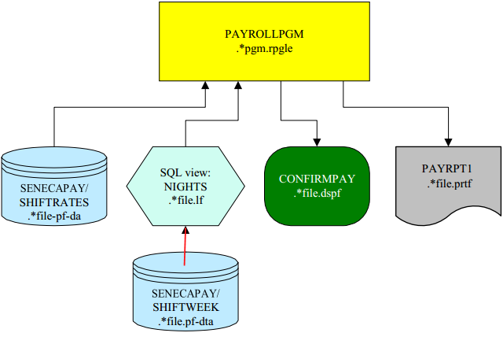
RPGLE Business Application (with printer/database files)
Lab 5 files:

Slide 9
Defining a Physical File in RPGLE
SQL and RPG
When defining a table, SQL doesn’t follow the rules that the record format name must be different than the table name.
The RPG program does not allow the record format to be the same as the file/table name.

Slide 10
Defining a Physical File in RPGLE
Solve the SQL problem
Specifying RENAME option on the RPGLE file definition so that the format is defined with a different name internal to the RPG program:
KEYWORDS:
RENAME(fileName:newRecName)
Define database files
DCL-F SHIFTWEEK USAGE(*INPUT) KEYED RENAME(SHIFTWEEK:SHIFTWEEKR);
DCL-F SHIFTRATES DISK USAGE(*INPUT); // RENAME(SHIFTRATES:SHIFTRATER);

Slide 11
Defining a Printer (Spooled) File
OverFLow INDicator – for Handling page overflow
Specify an indicator from *IN01 through *IN99
Use KEYWORDS: OFLIND
Example: OFLIND(*IN01)
Defining a Printer File
DCL-F PAYRPT PRINTER OFLIND(*IN01)

Slide 12
RPGLE: Handling page overflow
IF *IN01; // check *IN01 before write Detail
Write Title;
Write ColHdg;
*IN01 = *Off;
ENDIF;
Write EmpDetail;

Slide 13
Review: Operations on Screen Records
EXFMT
Write a screen record and waits for input (Write / Read operations)
e.g. LETGRADE = ‘F’ ;
EXFMT RECORD1;
WRITE
Writes a screen record to a file/display station (without a pause)
e.g. WRITE RECORED1;
EXFMT RECORD2;

Slide 14
Operations on Printer/Data Records
READ
Read a data (i.e. physical or db table) record then point to next record
e.g. READ ShiftRates;
READ SHIFTWEEK;
WRITE
Writes a printer/screen record to a file/display station
e.g. Write Title;
Write ColHdg;
Write EmpDetail;
%EOF (filename)
Checks for End of File
e.g. DOW NOT %EOF;

Slide 15
RCDFMT in SQL
RCDFMT in SQL (Creating view)
In the native database, files have record formats. It actually allows you to have multiple formats in a single file.
SQL does not support this. so when you create a file with SQL, a record format is assumed to be the same name as the file.
The RCDFMT allows you to override that behavior.

Slide 16
Logic for an RPG program that creates a report for all of the records in a file

Slide 17
Report Logic
Initialize Variables
Print the report heading
Read the first record and check for EOF
Loop until EOF
format the detail line
update the totals
print the detail line
read the next record
End of loop
Print the totals
End of program logic

Slide 18
Rounding Numbers in RPG
Eval (h)
Eval (h) hourlyrate =
hourlyrate * 1.07;

Slide 19
File Overrides
OVRDBF
A CLLE command: allows you to use a different file instead of the one that is defined by the RPG program
Example
OVRDBF ALLSHIFT NIGHTS
- Override all reference to the file ALLSHIFT to be directed to the view NIGHTS
DSPOVR

Slide 20
File Overrides
OVRPRTF
Changes attributes about the spooled file

Slide 21
Lab 5 Demo

Slide 22
Homework
Review lecture notes.
Complete Lab 5,
Prepare for Test 1 (midterm)

Slide 23
The End

